Slide 1
Artificial Intelligence
PAC-MAN
(with Deep Reinforcement Learning)
Mohammad Saif :. 2017UCO1695
Mohd Farman :. 2017UCO2526
Saurabh Mittal :. 2017UCO1666

Slide 2
About PacMan
Pac-Man is an arcade video game that was made by Namco and designed by Toru Iwatani. It was released in 1980, and became very popular in the history of games.
In Pac-Man, the player makes a Pac-Man, a yellow disc, move around a maze. The goal is to eat every golden points while not getting caught by the ghosts/monsters. For extra points, fruits that appear can also be eaten. When Pac-Man eats a white pellet, the ghosts turn blue and can be eaten.
We developed the Pac-Man from the scratch by keeping in mind the original gameplay and its sets of rule in Python Environment using PyGame module. We use simple image editing tools to make the screen layout, pac-man, Ghosts and Golden Points.
We converted into a GYM environment. After that, the keras-rl library is used to make, train and test the model.

Slide 3
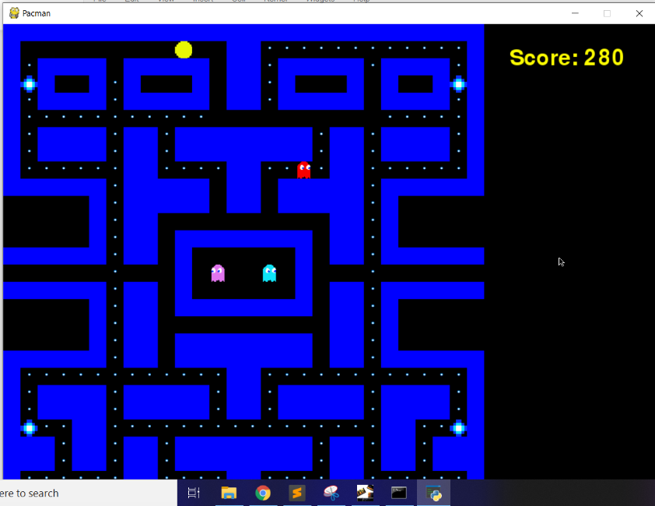
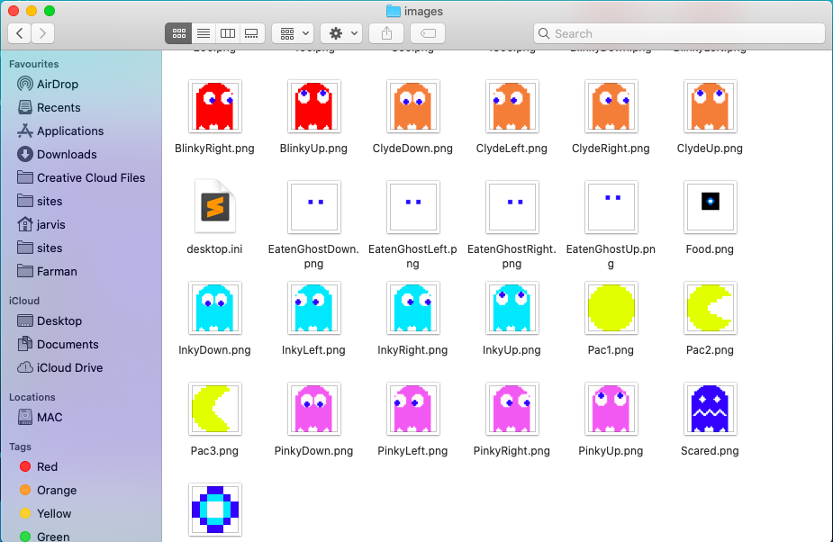
Pac-Man Layout

Slide 4
AI Techniques used in the project
Reinforcement learning (RL), In reinforcement learning, an agent exists within an environment and looks to maximize some kind of reward. It takes an action, which changes the environment and feeds it the reward associated with that change. Then it takes a look at its new state and settles on its next action, repeating the process endlessly or until the environment terminates.
Linear Annealed Policy is a technique for reducing a threshold value passed into it, linearly. Combined with Epsilon Greedy Policy, it becomes Linear Annealed Epsilon Greedy Policy.
A heuristic function, also called simply a heuristic, is a function that ranks alternatives in search algorithms at each branching step based on available information to decide which branch to follow. For example, it may approximate the exact solution.
Epsilon-Greedy Policy is a way of choosing an action from a set of available actions, by either choosing an action at random with the probability of epsilon, or choosing the best available action with a probability of 1 – epsilon .

Slide 5
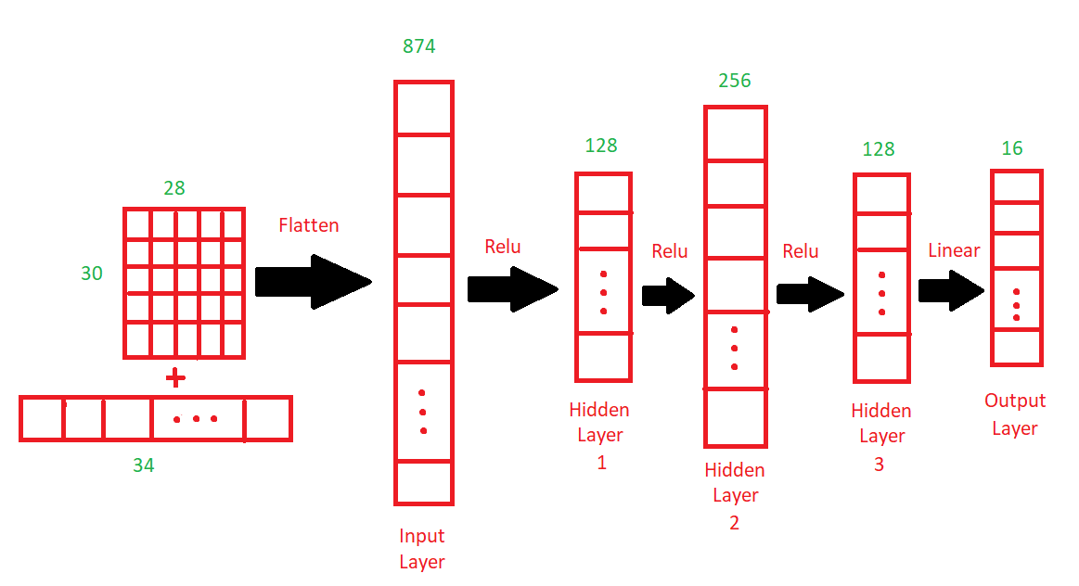
Neural network used

Slide 6
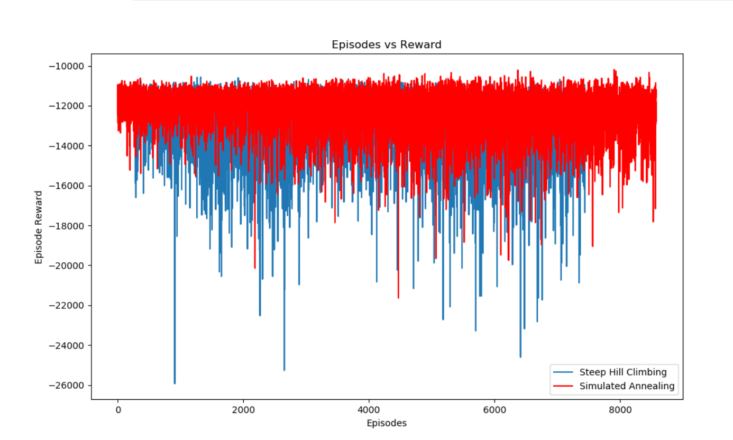
Comparison of Reward System in Policies

Slide 7
